Slide 1
Current state of cybersecurity
Rhode island water works association
Mike Tetreault
Cybersecurity Advisor RI
Cybersecurity and Infrastructure Security Agency
Notes:
Change Presenter’s Name and Date in Slide Master view.

Slide 2
Agenda
TLP:WHITE
Background and Best practices
Recent Advisories
Observations
Misconceptions v.s. Reality
Federal Cybersecurity
CISA Cybersecurity Service Offerings Overview
Q&A
2

Slide 3
Background – Water Sector Cyber
TLP:WHITE
Cybersecurity is the top threat facing business and critical infrastructure in the United States, according to reports and testimony from the Director of National Intelligence, the Federal Bureau of Investigation, and the Department of Homeland Security.
Breaches in cybersecurity practices can compromise the ability of drinking water to provide clean and safe drinking water to customers, erode customer confidence and result in financial and legal liabilities.
3

Slide 4
Best Practices – Water Sector Cyber
TLP:WHITE
All drinking water systems and wastewater systems should:
examine cybersecurity vulnerabilities
develop a cybersecurity risk management program
mitigating a cyberattack from impacting system operations
Cyber-attacks against public water system facilities are increasing
Implementing basic cyber hygiene practices is essential
prevent, detect, respond, and recover from cyber incidents
This training will consist of:
an overview on cybersecurity in the water sector
ransomware awareness and prevention
review of cybersecurity incidents in the water industry
a discussion about the SCADA Cybersecurity Framework
4

Slide 5
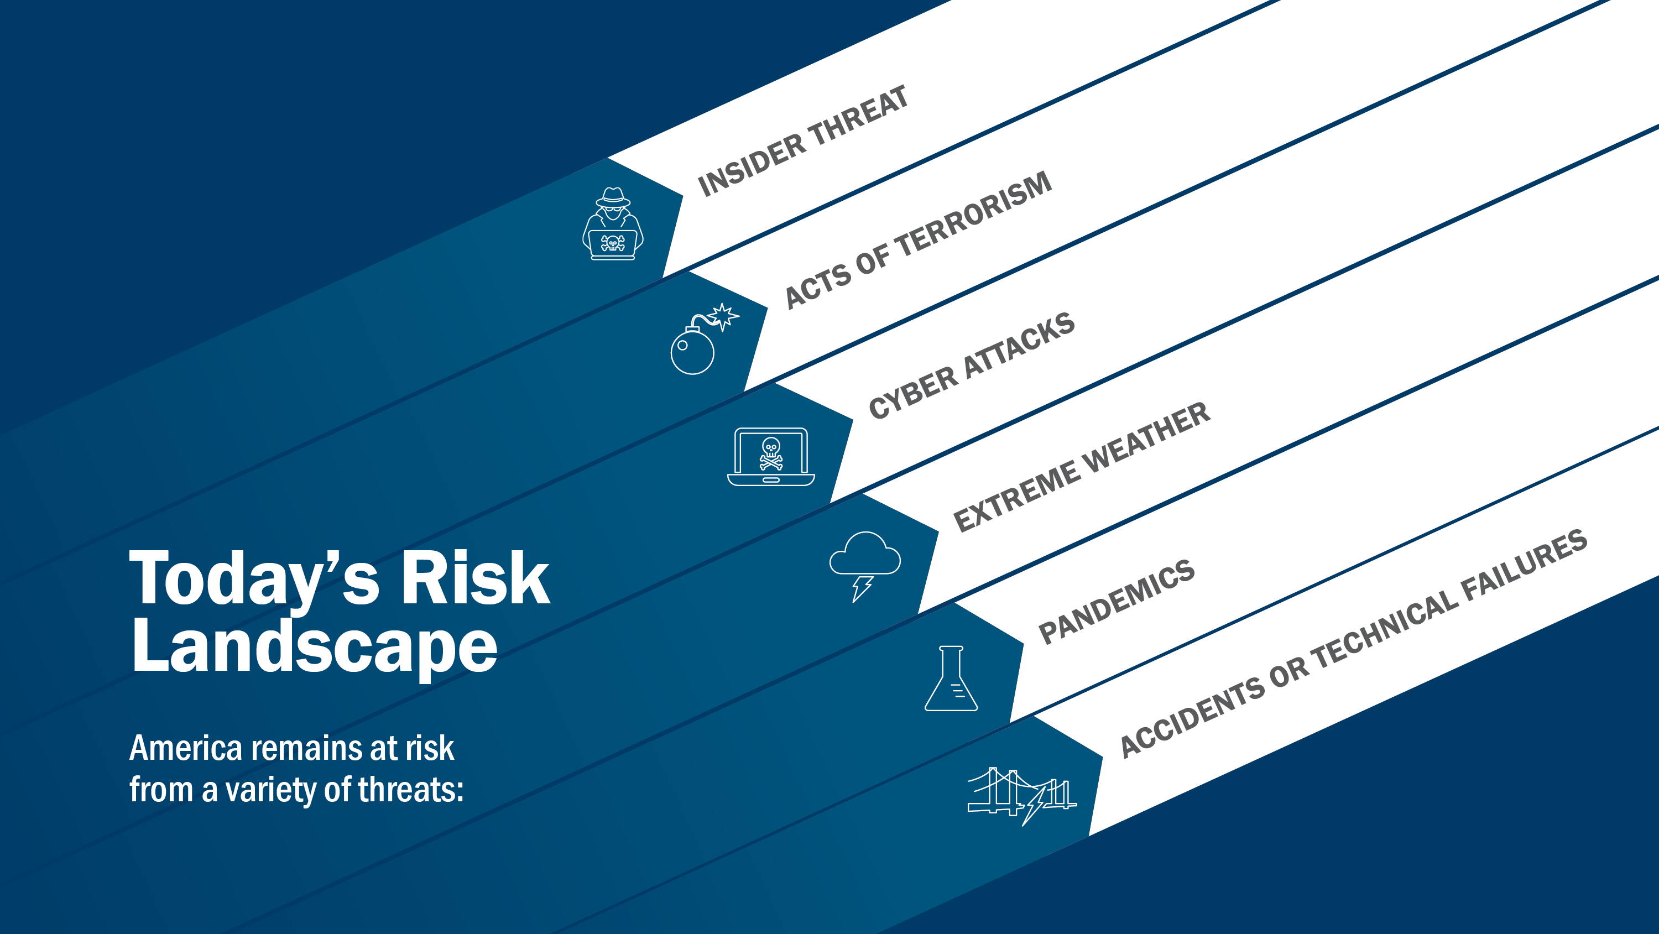
Notes:
Worldwide Threat Assessment report (Jan 2019) warned that “[o]ur adversaries and strategic competitors will increasingly use cyber capabilities – including cyber espionage, attack and influence – to seek political, economic, and military advantage over the United States.”
Cyber and physical threat (CyPhy) is a way of life in this interconnected world we live in.
This slide shows a broad scope of threats. These are a handful of sources—you might ask “where is cyber crime?” It falls under cyber attacks.
As you can see, we must fortify our organizations and critical infrastructure against a variety of adversaries.

Slide 6
Recent Advisories
TLP:WHITE
CISA Alert (AA21-042A): Compromise of U.S. Water Treatment Facility
CYBER: On February 5, 2021, unidentified cyber actors obtained unauthorized access to the supervisory control and data acquisition (SCADA) system at a U.S. drinking water treatment facility.
PHYSICAL CONVERGENCE: The unidentified actors used the SCADA system’s software to increase the amount of sodium hydroxide, also known as lye, a caustic chemical, as part of the water treatment process.
The cyber actors likely accessed the system by exploiting cybersecurity weaknesses, including poor password security, and outdated/unsupported operating systems.
General Recommendations
UPDATE to the latest version of the operating system (e.g., Windows 10).
Use multiple-factor authentication (MFA).
Use strong passwords to protect Remote Desktop Protocol (RDP) credentials.
Ensure anti-virus, spam filters, and firewalls are up to date, properly configured, and secure.
AUDIT network configurations and ISOLATE computer systems THAT CANNOT BE UPDATED.
Audit your network for systems using RDP, closing unused RDP ports, applying multiple-factor authentication wherever possible, and logging RDP login attempts.
TRAIN users to identify and report attempts at social engineering.
Identify and suspend access of users exhibiting unusual activity.
https://us-cert.cisa.gov/ncas/alerts/aa21-042a
Notes:
General Recommendations
The following cyber hygiene measures may help protect against the aforementioned scheme:
Update to the latest version of the operating system (e.g., Windows 10).
Use multiple-factor authentication.
Use strong passwords to protect Remote Desktop Protocol (RDP) credentials.
Ensure anti-virus, spam filters, and firewalls are up to date, properly configured, and secure.
Audit network configurations and isolate computer systems that cannot be updated.
Audit your network for systems using RDP, closing unused RDP ports, applying multiple-factor authentication wherever possible, and logging RDP login attempts.
Audit logs for all remote connection protocols.
Train users to identify and report attempts at social engineering.
Identify and suspend access of users exhibiting unusual activity.

Slide 7
Recent Advisories (Cont.)
TLP:WHITE
CISA Alert (AA21-042A): Compromise of U.S. Water Treatment Facility
CYBER: On February 5, 2021, unidentified cyber actors obtained unauthorized access to the supervisory control and data acquisition (SCADA) system at a U.S. drinking water treatment facility.
PHYSICAL CONVERGENCE: The unidentified actors used the SCADA system’s software to increase the amount of sodium hydroxide, also known as lye, a caustic chemical, as part of the water treatment process.
The cyber actors likely accessed the system by exploiting cybersecurity weaknesses, including poor password security, and outdated/unsupported operating systems.
WWS Security Recommendations
The following physical security measures serve as additional protective measures:
Install independent cyber-physical safety systems. These are systems that physically prevent dangerous conditions from occurring if the control system is compromised by a threat actor.
Examples of cyber-physical safety system controls include:
  Size of the chemical pump
  Size of the chemical reservoir
  Gearing on valves
  Pressure switches, etc.
https://us-cert.cisa.gov/ncas/alerts/aa21-042a
Notes:
General Recommendations
The following cyber hygiene measures may help protect against the aforementioned scheme:
Update to the latest version of the operating system (e.g., Windows 10).
Use multiple-factor authentication.
Use strong passwords to protect Remote Desktop Protocol (RDP) credentials.
Ensure anti-virus, spam filters, and firewalls are up to date, properly configured, and secure.
Audit network configurations and isolate computer systems that cannot be updated.
Audit your network for systems using RDP, closing unused RDP ports, applying multiple-factor authentication wherever possible, and logging RDP login attempts.
Audit logs for all remote connection protocols.
Train users to identify and report attempts at social engineering.
Identify and suspend access of users exhibiting unusual activity.

Slide 8
CISA Cyber Hygiene Observations
COMMON WEAKNESSES & THREATS:
PHISHING SUSCEPTIBILITY
USER/ACCOUNT PERMISSIONS
PATCH MANAGEMENT
UNSUPPORTED OPERATING SYSTEM & APPLICATIONS
POTENTIALLY RISKY SERVICES
NETWORK SEGMENTATION/CONFIGURATION
Notes:
The WWS Sector is a target for:
• Advanced Persistent Threats (APTs) backed by foreign governments that may seek to disrupt U.S. critical functions and economic interests.
• Cybercriminals interested in profiting from data breaches and ransomware payments.
WWS entities, regardless of their size, are likely to be targeted by threat actors. Sophisticated attackers—interested in significant public health and economic impacts—are most likely to target larger entities. Both sophisticated and unsophisticated attackers are likely to target small- and medium-sized entities; these organizations’ smaller cybersecurity budgets make them lower stakes testing environments for APTs and targets of opportunity for less-skilled actors.
CyHy Automated Vulnerability Scanning tools are frequently deployed to monitor internet-accessible systems for known vulnerabilities, configuration errors, and suboptimal security practices. CISA scans Internet Protocol (IP) addresses with the Nmap network scanner and probes responsive hosts with the Nessus vulnerability scanner to identify critical, high, medium, and low severity vulnerabilities based on the Common Vulnerability Scoring System (CVSS) scale of 0 to 10. Nessus references the National Vulnerability Database (NVD) for its vulnerability information.
Scans use the range of IP addresses provided by the scanned entity. Using these tools, CISA can identify potential and known security issues, and can then recommend mitigations to the impacted stakeholder.
PHISHING SUSCEPTIBILITY
Observation: Successful phishing attacks allow an attacker initial access to an entity’s network. WWS entity personnel were found to be susceptible to phishing attacks in PCAs; and, separately, RVA teams were able bypass email filtering controls to launch spear-phishing in all WWS assessments. In addition, PCAs for WWS entities had a 3.6 percent click rate and only a 1 percent report rate for phishing emails.
Mitigation: Entities can reduce their workforce’s phishing susceptibility through increased user awareness training and simulations. Additionally, entities can block most common phishing attacks by implementing automated border and host-level protections. WWS entities should regularly analyze these protections—including spam-filtering capabilities—to ensure their continued effectiveness in blocking the delivery and execution of malware.
Best Practice: Train users, operators, and security personnel on how to prevent and reduce social engineering susceptibility, report incidents, and initiate incident response procedures.15,16 Develop and test incident response plans and procedures.
PATCH MANAGEMENT
Observation: Threat actors scan for and target vulnerable internet-accessible hosts to launch attacks. CISA scanning indicated that 61 percent of WWS entities experienced a critical or high vulnerability on at least one internet-accessible host during FY20. The median days to remediate vulnerabilities for WWS entities was 61 days for critical vulnerabilities and 154.4 days for high vulnerabilities. In addition, WWS entities’ volume of active vulnerabilities per entity increased from 27.6 to 30.4 in FY20. Entities experiencing a growing vulnerability backlog over time increase the likelihood that one or more of those vulnerabilities are used as part of an attack.
Mitigation: Entities should seek to reduce the backlog of vulnerabilities, especially those with known exploits that could be used to breach the defensive perimeter. Entities should modify patch management strategies to prioritize patching critical vulnerabilities with proven exploits on high-impact systems first, and reduce time to remediate vulnerabilities.
Best Practice: Follow established enterprise network best practices for IT infrastructure, including the implementation of a strong patching methodology for OS, applications, and firmware. Consider managing limited resources to patch vulnerabilities that present the most risk first, ranking prioritization by criticality, known exploits, and any threat-related information about specific vulnerabilities.
UNSUPPORTED OPERATING SYSTEM VERSIONS
Observation: Threat actors target unsupported OS versions because their lack of security patches and updates increase the ease of exploitation. In Q4 of FY20, 26 percent of observed WWS entities had at least one internet-accessible host running an unsupported OS version.
Mitigation: Entities should plan upgrades for aging systems and replace end-of-support components when possible with supported and secure versions. When replacement is not possible, organizations should use network segmentation for vulnerable systems.
Best Practice: Entities should replace equipment—including software, firmware, OS, and hardware—that is no longer supported, and isolate exceptions if replacement is not a viable option.
POTENTIALLY RISK SERVICES
Observation: Potentially vulnerable risky services, like FTP, Remote Procedure Call (RPC), and RDP, that are exposed to the internet present possible entry and escalation points for attackers. Throughout FY20, 35 percent of WWS entities scanned were running at least one potentially risky service on an internet-accessible host.
Mitigation: Entities should restrict, secure, and patch potentially risky services exposed to the internet and assess their legitimate business use cases. In some cases, operating potentially risky services with a level of security control is acceptable, such as connecting through virtual private networks (VPNs), using multifactor authentication (MFA), and encryption through tunneling.18
Best Practice: Securely configure or completely limit internet-accessible assets to only those needed to run entity operations. Isolate high-value assets, including operational technology systems, from the internet whenever possible. Use network segmentation to create layers of defense to protect critical systems and assets.

Slide 9
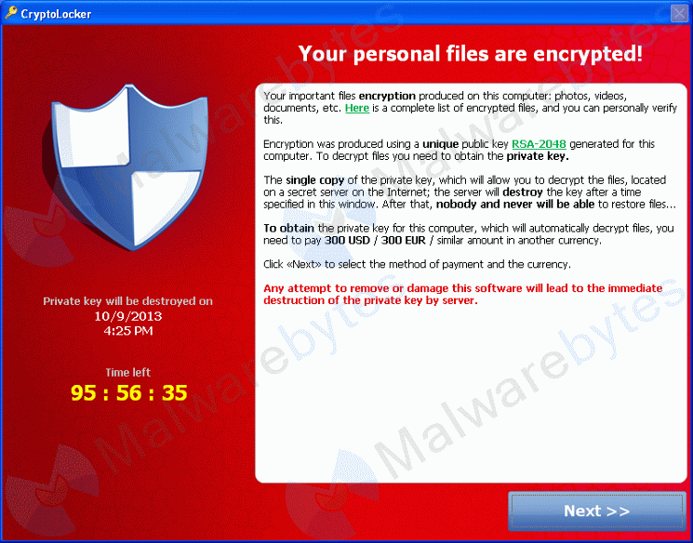
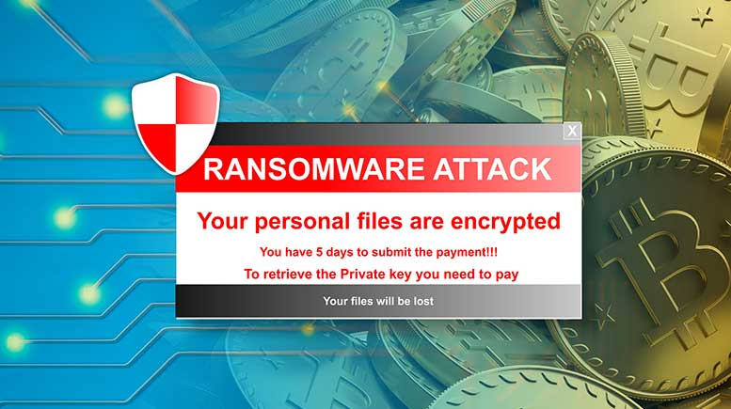
RANSOMWARE
TLP:WHITE
  WHAT IS RANSOMWARE AND HOW DOES IT WORK?
  WHO IS AT RISK OF A RANSOMWARE ATTACK?
  HOW BIG OF A PROBLEM IS RANSOMWARE?
Notes:
What is Ransomware?
Ransomware is malicious software, or malware, that once inserted into a network, is designed to encrypt files, preventing the owner from accessing them or locking the user out of their device or network. o Cybercriminals use ransomware to demand a fee— or “ransom”— in exchange for decryption of the encrypted files.
o The bad actors often threaten to sell or leak the stolen data or authentication information if a ransom is not paid.
o Many companies are being asked to pay twice - first to unlock their systems and then to avoid having sensitive data leaked.
o Many post evidence of their exploits to dedicated “leak sites” on the dark web to increase pressure on their victims to pay.
• Ransomware is a destructive attack, not an event where you can simply pay off the bad actor and regain control of your network. o Don’t trust a cybercriminal!
WHO IS AT RISK OF A RANSOMWARE ATTACK?
Any internet-connected computer or device is at risk of infection – this is all of us.
Ransomware attacks have surged among state, local, tribal, and territorial (SLTT) governments and critical infrastructure organizations. o It is an epidemic, affecting cities, police, hospitals, schools, manufacturing, and critical infrastructure targets.
o A recent Emsisoft report found 100+ federal, state and municipal agencies, 500+ medical centers, and 1,680 educational institutions in the U.S. were hit by ransomware in 2020
HOW BIG OF A PROBLEM IS RANSOMWARE?
A report by Emsisoft estimated that in the U.S., $3.6 billion in ransoms were paid in 2020. The same report estimates that when downtime is factored in, the cost of ransomware in the U.S. was nearly $20 billion.

Slide 10
RANSOMWARE
TLP:WHITE
HOW CAN YOU IMPROVE YOUR CYBERSECURITY?
To minimize the risks of cyberattacks, follow basic cybersecurity best practices:
  Update software and install patches.
  Run up-to-date antivirus software.
  Use strong passwords. A password manager can help keep track of them.
  Change default usernames and passwords as soon as possible.
  Implement multi-factor authentication, where you log in using a password and something else– like a code texted to your phone– to verify it’s really you.
  Install, configure, and enable a firewall.
  Be suspicious of unexpected emails! They could be phishing to gain information, steal money, or install malware on your device.
CISA has many resources and tips on CISA.gov, including Cyber Essentials which provides organizations with valuable information to bolster their cybersecurity.
Notes:
What is Ransomware?
Ransomware is malicious software, or malware, that once inserted into a network, is designed to encrypt files, preventing the owner from accessing them or locking the user out of their device or network.
o Cybercriminals use ransomware to demand a fee— or “ransom”— in exchange for decryption of the encrypted files.
o The bad actors often threaten to sell or leak the stolen data or authentication information if a ransom is not paid.
o Many companies are being asked to pay twice - first to unlock their systems and then to avoid having sensitive data leaked.
o Many post evidence of their exploits to dedicated “leak sites” on the dark web to increase pressure on their victims to pay.
• Ransomware is a destructive attack, not an event where you can simply pay off the bad actor and regain control of your network.
o Don’t trust a cybercriminal!
WHO IS AT RISK OF A RANSOMWARE ATTACK?
Any internet-connected computer or device is at risk of infection – this is all of us.
Ransomware attacks have surged among state, local, tribal, and territorial (SLTT) governments and critical infrastructure organizations. o It is an epidemic, affecting cities, police, hospitals, schools, manufacturing, and critical infrastructure targets.
o A recent Emsisoft report found 100+ federal, state and municipal agencies, 500+ medical centers, and 1,680 educational institutions in the U.S. were hit by ransomware in 2020
HOW BIG OF A PROBLEM IS RANSOMWARE?
A report by Emsisoft estimated that in the U.S., $3.6 billion in ransoms were paid in 2020. The same report estimates that when downtime is factored in, the cost of ransomware in the U.S. was nearly $20 billion.

Slide 11
Misconceptions Vs. Reality
TLP:WHITE
MISCONCEPTIONS:
You need a BIG budget!
A Silver Bullet Solution!
Why would we be a target?
There’s too much to do!
We don’t own the risk!
USG will save us!
REALITY:
Crawl-Walk-Run
Get the “101” stuff in order
You need good asset inventory
Research the solutions!
You own the risk!
Partner-up!
11

Slide 12
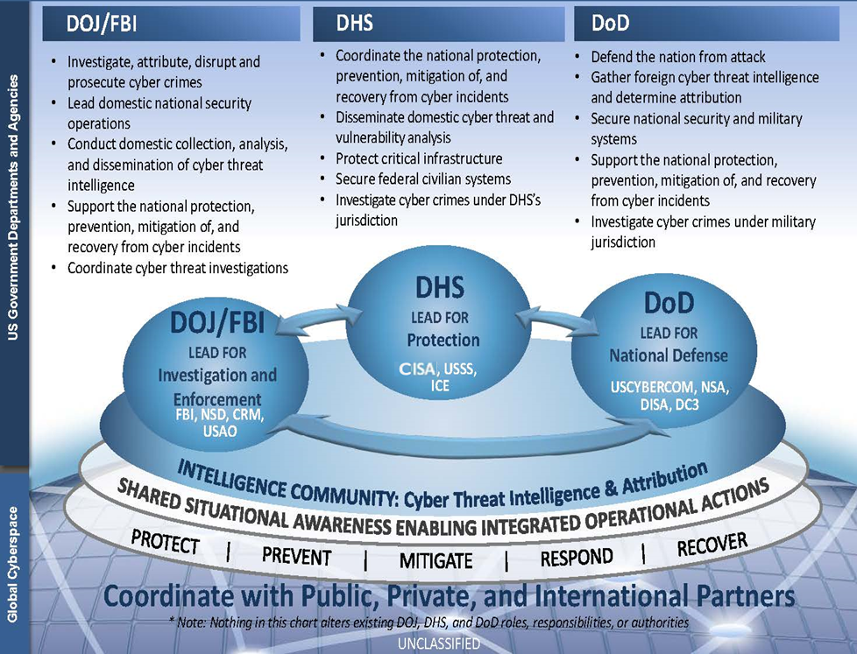
Federal Cybersecurity
TLP:WHITE
Whole of Government Response
(DOJ/FBI, DHS/CISA, DoD)
Presidential Directives
  HSPD 5 — Domestic Incidents
  PPD 8 — National Preparedness
  PPD 21 — Critical Infrastructure Security & Resilience
  PPD 41 — US Cyber Incident Coord Activities Defined
Disseminates Domestic Cyber Threat Information
Protects Critical Infrastructure
Secures Federal Civilian Executive Branch Systems
Directives are implemented through doctrine, policy, plans
  National Cyber Strategy
  National Preparedness System
  National Infrastructure Protection Plan (NIPP)
  National Cyber Incident Response Plan (NCIRP)
12

Slide 13
Cybersecurity Advisor Program
TLP:WHITE
CISA mission: Lead the collaborative national effort to strengthen the security and resilience of America’s critical infrastructure
In support of that mission: Cybersecurity Advisors (CSAs):
  Assess: Evaluate critical infrastructure cyber risk.
  Promote: Encourage best practices and risk mitigation strategies.
  Build: Initiate, develop capacity, and support cyber communities-of-interest and working groups.
  Educate: Inform and raise awareness.
  Listen: Collect stakeholder requirements.
  Coordinate: Bring together incident support and lessons learned.
Notes:
As I said, we at CISA have one mission: to lead the collaborative national effort to strengthen the security and resilience of America’s critical infrastructure. We do so by providing direct coordination, outreach, and regional support and assistance to protect cyber components essential to the Nation’s critical infrastructure.
The purpose of CISA’s Cybersecurity Advisor program is to promote and further cybersecurity preparedness, risk mitigation, and incident response capabilities of public and private sector owners and operators of critical infrastructure, and state, local, tribal, and territorial (SLTT) governments, through stakeholder partnerships and direct assistance activities which we undertake with you at no cost to you. All our services, programs, and tools we offer to you are strictly voluntary – you do not have to use any of them – and ALL are free – there is no charge to you whatsoever for any service and tool we offer.
Specifically, to promote the security and resilience of critical infrastructure we:
Undertake risk-based cybersecurity assessments -- such as the Cyber Resilience Review (CRR), Cyber Infrastructure Survey (CIS), and the External Dependencies Management (EDM) assessment, which are all free to the critical infrastructure owner and operator, whether SLTT or private sector;
Promote use of best practices such as the NIST Cybersecurity Framework, which is designed as a foundation upon which industry and government can better manage and reduce their cyber risk;
Build and strengthen private-public cybersecurity partnerships through information exchanges, and cyber protective visits;
Educate by raising awareness of various cybersecurity services offered by CISA and other federal and local government programs through cyber resilience workshops, keynotes, panel discussions, and program briefs;
Listen to stakeholder requirements and needs through various working groups, tabletop exercises, and other technical exchanges; and
Coordinate direct assistance and resourcing support conducted in times of cyber threats, disruptions, and attacks.

Slide 14
CISA Cybersecurity Offerings
TLP:WHITE
Local CSA Provided
CISA HQ Response Assistance
  Remote / On-Site Assistance
  Malware Analysis
  Hunt and Incident Response Teams
  Incident Coordination
Cybersecurity Advisors (CSA)
  Assessments
  Working group collaboration
  Resiliency Workshops
  Best Practices private-public
  Incident assistance coordination
Protective Security Advisors
  Physical Security Assessments
  Incident liaisons between government and private sector for CI protection
  Support for National Special Security Events
Preparedness Activities
  Information/Threat Indicator Sharing
  Cybersecurity Training and Awareness
  Cyber Exercises and “Playbooks”
  National Cyber Awareness System
  Vulnerability Notes Database
  Information Products and Recommended Practices / MS-ISAC – EI-ISAC
  Cybersecurity Service Offerings
    Cyber Resilience Reviews (CRR)
    External Dependency Management (EDM)
    Cyber Infrastructure Surveys (C-IST)
    Cyber Security Evaluation Tool (CSET)
Delivered by CISA Vulnerability Mgt Team
Phishing Campaign Assessment (PCA)
Cyber Hygiene Scanning (CyHy)
Web Application Scanning (WAS)
Remote Penetration Testing (RPT)
Risk & Vulnerability Assessment (RVA)
Red Team Assessment (RTA)
Validated Architecture Design (VADR)
Critical Product Evaluation (CPE)
CISA Qualification Initiative (CQI)
Notes:
Explain all of the CISA & My role as a Cyber Security Advisor activities and offerings or outreach activities
I mentioned Preparedness activities, The list on the Left provides some examples of these types of resources that are available.
These primarily are geared for IT / Cybersecurity Professionals with K12 community, We know they have a tough job.
These range from Training and Awareness activities to Assisting these professionals with building and improving their Cybersecurity Programs as well as facilitating a Cyber Exercise. As well ensuring they are connected with Cyber Threat Alerts.
Under the Cybersecurity Service Offerings are specific services or assessments which are no cost offerings for the K12 community.
These fall into two categories – The first few items listed are examples of the assessments to review the K12 Cybersecurity Program.
The one’s in Bold are technical assessments where we assist IT / Cyber professionals by Testing the protection level of the Network. Please share these with your IT/Cybersecurity Peers.
On the Right.

Slide 15
CyHy: Cyber Hygiene Scanning
TLP:WHITE
System & Application Vulnerability Scanning
CRITICAL
HIGH
MEDIUM
LOW
NONE
INACTIVE
Automated scanning of Internet accessible systems (Top 1000 Ports / NMAP & NESSUS)
Weekly report card that include current scan results, historic trends, and result comparisons to the national average
Helps individual customers understand their exposure
Informs national risk management efforts
Federal agencies must mitigate critical vulnerabilities within 30 days of detection
Scans can start within 72 hours!
Unlimited capacity of subscribers
Notes:
Occurs as a continuous series of non-intrusive checks in order to identify existing or potential vulnerabilities and configuration weaknesses.
Weekly reporting intervals. Detailed findings included as exports
We begin by scanning, using Nmap, all submitted IPv4 addresses for the top 1000 ports. Hosts are next fully port scanned (TCP only) before we pipe results to our vulnerability scanner (Nessus, all plug-ins except the denial-of-service ones). Vulnerability scans recur depending on the criticality (CVSS) of the vulnerability found: We deliver a weekly report (encrypted with a shared secret password) to the email address that your organization prefers (we recommend a distro). These are usually sent Monday before noon (EST).

Slide 16
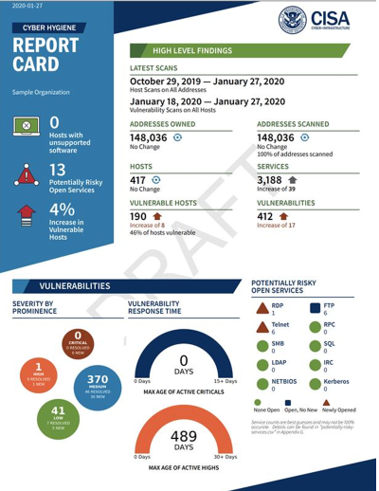
CyHy: Cyber Hygiene Scanning Report Card
TLP:WHITE
Notes:
And in case you want to share a sample report with prospective stakeholders, we've got one here: Cyber Hygiene Sample Report. It's got some great info on our scan methodology the prospective stakeholders might be interested in. It also shows how we have the detailed views that can be filtered or ingested by their data aggregators as CSV attachments within the PDF.
The only update we've made to it is that the Report Card page is newly formatted with some info on potentially risky servies (like RDP, which we know is a huge attack vector for ransomware). We hope to soon add some more updates, 508 compliant-ize it, and post a fully updated version up on the cisa.gov resource hub In the meantime, this is what the new Report Card page looks like:

Slide 17
CISA RPT – Remote Penetration Testing
TLP:WHITE
CISA Assessments’ Remote Penetration Test (RPT) Utilizes a dedicated remote team to assess and identify vulnerabilities and work with customers to eliminate exploitable pathways. RPTs are similar to risk and vulnerability assessments but focus only on externally accessible systems with a tradeoff made for more service capacity at the expense of assessment scope.
External Penetration Testing - Utilizes a dedicated remote team to assess and identify vulnerabilities and work with customers to eliminate exploitable pathways. Simulates the tactics and techniques of malicious adversaries.
External Web Application Testing – Evaluating web applications for potential exploitable vulnerabilities; the test can include automated scanning, manual testing, or a combination of both methods.
Phishing Campaign Assessment - Measures the susceptibility of an organization’s staff to social engineering attacks (specifically email phishing attacks) and provides a comprehensive assessment report is after its conclusion.
17

Slide 18
CISA REGION 1
MIKE TETREAULT
Cybersecurity Advisor, Rhode Island
Cybersecurity and Infrastructure & Security Agency
EMAIL: Roland.Tetreault@cisa.dhs.gov CISARegion1@hq.dhs.gov
WEB: WWW.CISA.GOV
WWW.CISA.GOV/REGION-1
CISA CENTRAL - 24/7 Watch
(888) 282-0870;Central@cisa.dhs.gov
FBI’s 24/7 Cyber Watch (CyWatch)
(855) 292-3937; CyWatch@fbi.gov
18

